Slide 1

IBM Employee Estimated Value (EEV) Increasing average EEV for IBM
ISSS621
Data Science for Business
Group 5
Fu Wanqian
Ho Zi Jun
Kuek Xiao Qi Debbie
Liang Xiuhao
Sarthak Jagdish Nagapurkar
Zou Jiaxun

Slide 2
Content
 | Agenda | Speakers
1. | Project Overview | Xiuhao
2. | Lengthen Tenure | Zi Jun & Sarthak
3. | Improve Performance | Debbie
4. | Improve Satisfaction Scores | Zou Jiaxun
5. | Data Ecosystem & Conclusion | Wanqian

Slide 3
Why is Talent Management Important?
01 Attrition is costly for the company | 02 No one size fits all HR strategies | 03 Development in Data Science allows for targeted interventions
For each employee lost, the cost to the company could be 50%–250% of his/her annual salary | Significant diversity in modern workforce | Data availability and development of machine learning and modelling
Notes:
Attrition cost: https://learning.linkedin.com/content/dam/me/learning/en-us/pdfs/lil-workbook-calculating-cost-of-employee-attrition-and-disengagement.pdf

Slide 4
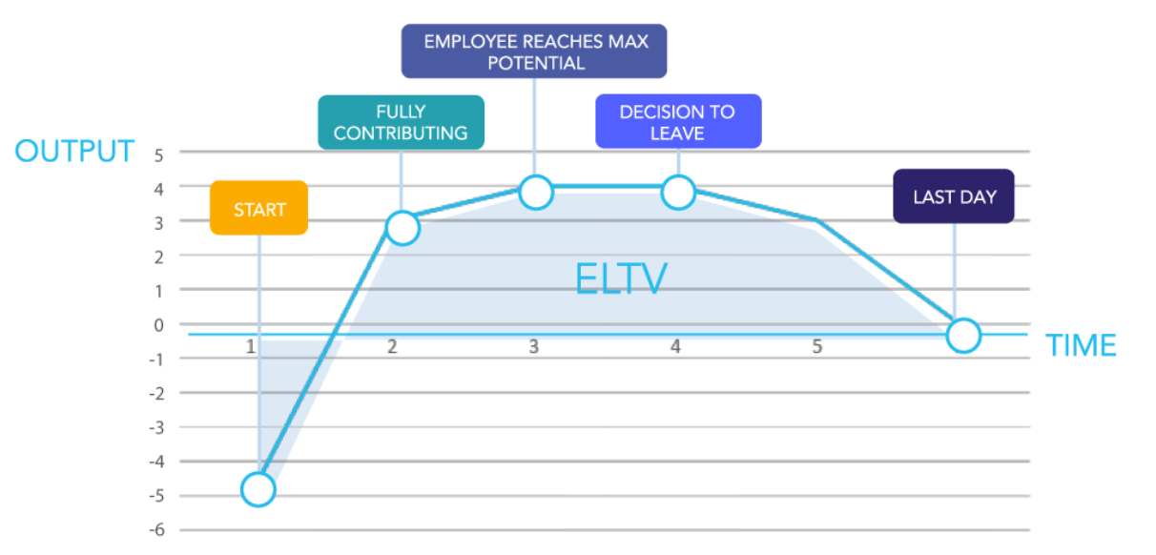
What is Employee Lifetime Value (ELV)?
ELV is a metric used to quantify the total value an employee brings to a company over the duration of their employment.
It considers both the costs and the benefits associated with hiring, training, retaining, and losing an employee.

Slide 5
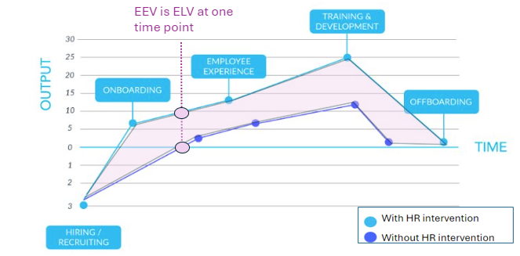
Employee Estimated Value (EEV) An adaptation of Employee Lifetime Value (ELV)
We can always improve EEV by HR strategies, but how do we know which HR strategies to apply to who and when?
+
How do we know that the chosen HR strategy is the best choice for IBM?
For IBM, we want to maximize the increase in EEV with the lowest cost to IBM.
Business Problem: How can we optimize cost when improving individual Employee Estimated Value (EEV)?​

Slide 6
Analytical Framework
Overall Metric:
Employee Estimated Value (EEV) = Experience + Performance + Environment
Business Problem | Sub-Objectives | Data Science Task | Business Impact | Sub-Metric
How can we optimize cost when improving individual Employee Estimated Value (EEV)?
Identify likelihood of attrition for all employees
Management decision to target retention efforts to at risk employee
Lengthen Tenure
(Experience)
Cost of Attrition
Cost of attrition per employee
Improve Performance
(Performance)
Maximize budget for benefits to improve identified factor for performance
Identify factors impacting performance
Performance level
Identify factors impacting promotion and timeline
Recommend suitable promotion timepoint
Job satisfaction level
Improve Satisfaction Scores
(Environment)
Causal relationship between benefit and satisfaction level
Recommend the best employee benefit to be implemented
Worklife balance / environmental satisfaction
Notes:
Robert:
Promotion timeline
Performance is not correlated, maybe because of Probable reason why: seniority based timeline, biasness - organisational culture
To understand promotion was done right -> use job satisfaction level (before and after)

Slide 7
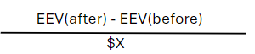
Overall Evaluation Metric: EEV to Cost Ratio (ECR)
Individual EEV = w1 x Performance + w2 x Experience + w3 x Environment
Wi = [ 0.5 , 0.3 , 0.2 ] Given by company prioritization of valuing skilled and high performing individuals, followed by loyal employees with long tenure, and finally, the notion of satisfied employees improves company's value.
Wi can be adjusted based on change in company prioritization and philosophy.
Average Company EEV = Σ (individual EEV) / Total no. of employee
Cost for training, benefits, attrition = Cost estimation based on historical data = $X
Naïve | Heuristic | Data Science
Apply to all employees | Apply by Targeted Segmentation, e.g. Performance Rating of 4 (High Performers by Heuristic segmentation) | Apply by clusters / at-risk employees with feature of importance, targeted intervention based on EEVs.
Criteria for choosing business recommendation:
Calculate total cost for HR strategies = $X
Calculate difference in average company EEV before and after implementation = EEV(after) - EEV(before)
EEV to Cost Ratio (ECR) =
Optimize cost, i.e. find highest possible ECR based on cost modeling.
Intuitive understanding of ECR:
increase in EEV per dollar cost ($)

Slide 8
Data Exploration – IBM Dataset
Dataset - 1471 rows, 35 columns
Each row represents a record of an employee
Each column represent a variable in HR of the employee
Data Preparation
Categorical data was converted into int when required in our model
No missing / Null / Duplicated values in dataset
Data was transformed when required such as using log transformation
No extreme outliers omitted for analysis
*For Categorical variables: (0-3) / (1-4) A higher number indicates a higher scale for specified variable
*Overtime and Attrition: Yes & No
Key Variables of Interest | Data Type | Description from Data Dictionary
Attrition | Categorial | Outcome variable of employee status
Monthly Income | Numerical | Monthly salary of the employee
Overtime | Categorical | Indication of whether the employee has worked after his/her standard working hours
Age | Numerical | Total years lived by the employee
Total Working Years | Numerical | Total years the employee has worked
StockOptionLevel | Categorical | Proportion of the employee’s income spent on purchasing the company’s stocks. (0 –3)
Distance From Home | Numerical | Distance between the employee’s home and the company, measured in KM
JobSatisfaction | Categorical | Degree to which the employee is satisfied with his / her job. (1 – 4)
BusinessTravel | Categorical | Indication of whether the employee travels abroad for work-related purposes.

Slide 9
Data Exploration – Demographics of Employees
Notes:
Histogram: Shows the overall distribution of total working years among employees.
Boxplot: Highlights the range, median, and potential outliers in total working years.
Distribution Plot: Compares the distribution of total working years between employees who left and those who stayed.

Slide 10

Subobjective 1: Lengthen Tenure
Identify likelihood of attrition for all employees
Cost of attrition per employee

Slide 11
Sub-objective 1: Lengthen Tenure
Metric:
Cost of Attrition
Approach: Identify at-risk employees and calculate the cost to IBM if they leave
Identify at-risk employees
Identify the top factors affecting attrition
Link EEV of employees to retention strategy.
Data Science Tasks:
Classify employees as “at-risk” or “not-at-risk” using Predictive Modelling
Calculate the cost of attrition of employees
Generate a priority list of employees to retain
Recommendation: Based on the priority list of employees to retain and the top factors affecting attrition craft a retention strategy
Sub-objective 1:
Lengthen tenure
Identify the likelihood of attrition for all employees
Calculate the cost of attrition for at-risk employees
Management decision for targeted efforts for retention of at-risk employees
Notes:
To achieve this sub-objective, first, we need to identify at-risk employee and the factors causing their attrition. But do we retain all the employees at risk of attrition? Of course not. Regarding crafting a retention strategy, IBM has constraints like budget, revenue per employee, total headcount, etc. So next we can calculate the actual loss to the company in monetary terms if a specific employee leaves based on his performance, experience, and cultural fit which is captured in our EEV score. Then we can get a priority list of at-risk employees to retain based on the value they add to the company. The strategy can be crafted based on this priority list and factors affecting attrition.

Slide 12
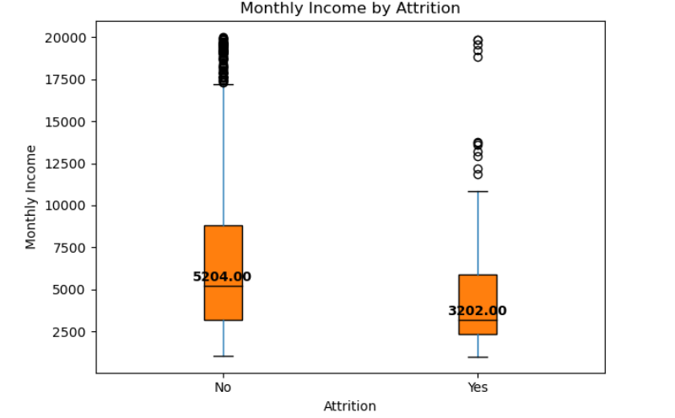
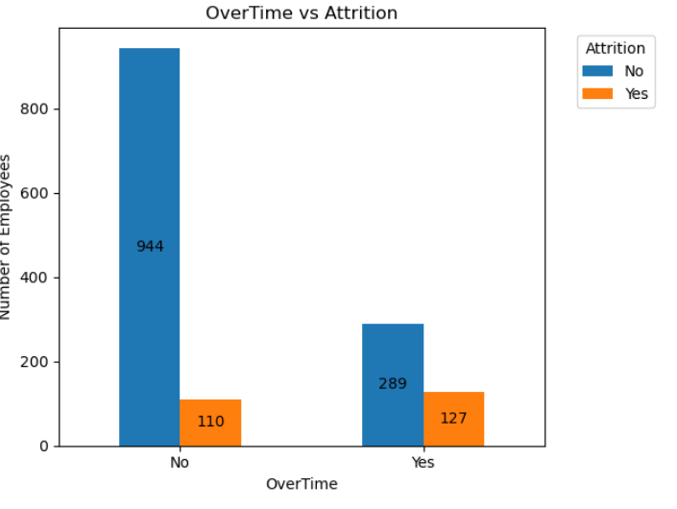
Exploring factors affecting attrition
Overall Observations: Higher Attrition in Employees working overtime and those having lower monthly salaries
Metric:
Cost of Attrition
Sub-objective 1:
Lengthen tenure
Identify the likelihood of attrition for all employees
Calculate the cost of attrition for at-risk employees
Factor | Observation | Interpretation
Overtime | 30% of employees working overtime leave the company compared to 10% for those staying. | Work-life balance may be a significant factor causing attrition
Monthly Income | Median monthly salary of employees leaving is roughly 2000$ lower than ones staying. | Employees probably leave if they perceive themselves as underpaid
Management decision for targeted efforts for retention of at-risk employees
Notes:
EDA to present:
MonthlyIncome, OT (slide 11)
MaritalStatus, Age (Slide 12)

Slide 13
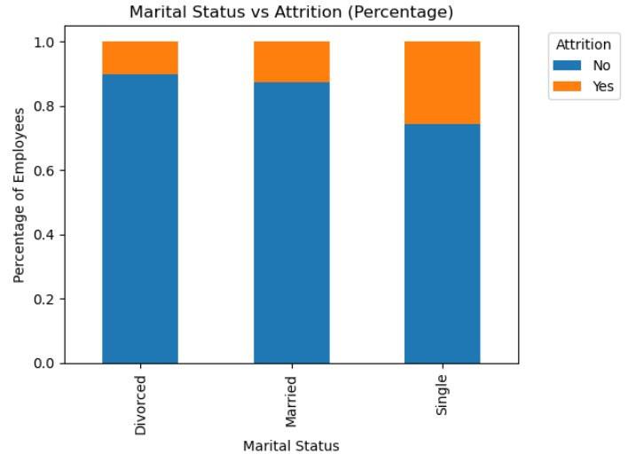
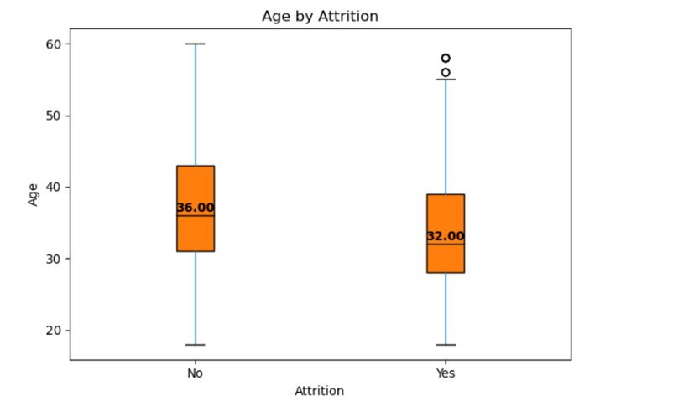
Exploring factors affecting attrition
Metric:
Cost of Attrition
Overall Observation: High Attrition in Singles as well as younger employees.
Sub-objective 1:
Lengthen tenure
Identify the likelihood of attrition for all employees
Calculate the cost of attrition for at-risk employees
Factor | Observation | Interpretation
Marital Status | 26% significant portion of single employees left the company Highest compared to other marital status | Singles might be leaving due to needing a different work environment or job satisfaction
Age | Median age of employees leaving the company is 32 as compared to 36 for others. | Older employees might be staying due to job stability or due to family responsibilities.
Management decision for targeted efforts for retention of at-risk employees

Slide 14
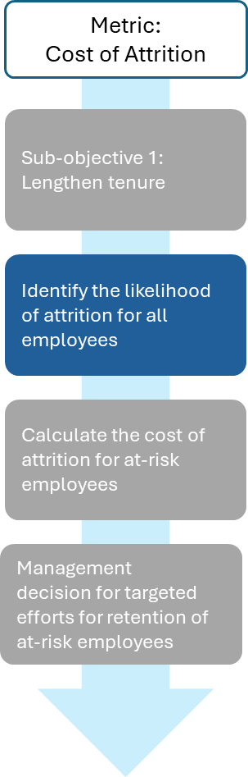
How to craft our retention strategy?
Based on insights from EDA, craft a retention policy for singles, employees working overtime, and younger employees.
Can we do better to identify the employees that are leaving?
Data Science solution: Can we classify each employee as at-risk of leaving and not-at-risk?

Slide 15
Predictive Modelling to classify at-risk employees
Metric:
Cost of Attrition
Random Forest outperforms Logistic and Naïve bayes classifier based on below metrics
Class 0: Attrition_No, Class 1: Attrition_Yes
Sub-objective 1:
Lengthen tenure
Models | Accuracy | Average F1 Score
Random Forest Classifier | 0.86 | 0.66
Logistic Regression | 0.84 | 0.55
Naïve Bayes Classifier | 0.76 | 0.66
Identify the likelihood of attrition for all employees
Evaluation of Results
Target Class 1 - Attrition is highly imbalanced (10%) out of the total employees. Accuracy alone may not be a good measure of model performance.
Average F1 and Accuracy scores both need to be considered to assess the model performance as that will help us understand how the model performs on Class 1(Attrition: True)
Calculate the cost of attrition for at-risk employees
Management decision for targeted efforts for retention of at-risk employees
Random Forest Classifier performs better than Logistic Regression and Naïve Bayes Classifier on
Accuracy, and Average F1 scores.
Notes:
Choose Random Forest if you need high accuracy, can handle the computational complexity, and are dealing with complex, non-linear data.
Choose Logistic Regression if you need a simple, interpretable model, have linear relationships in your data, or need to conserve computational resources.
Choose Naive Bayes if you are working with text data, need a quick and efficient model, and the independence assumption is not a significant issue.

Slide 16
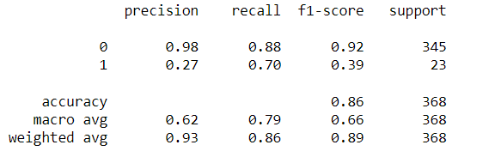
Predictive Modelling – Random Forest Classifying at-risk employees
Predictive Model to classify potential attrition of an employee.
Classifying leaving employees correctly is of higher importance than classifying non-leaving employees correctly.
 | Approach | Results
Pre-Training | Address Class Imbalance using SMOTE to oversample the minority class in training dataset. Stratified sampling was used on Attrition class for train test data split.
Training | Fit a Random Forest Classifier Model on training data.
Evaluation | Use classification report to assess performance on test data. Class 1 Recall (% of Leaving employees identified correctly) can be considered most important metric to identify model performance. | Class 1 Recall: 70% accuracy in identifying employees that will leave correctly out of all employees leaving.
 |  | Overall accuracy: 86% overall accuracy in classifying the potential attrition of employee
 |  | Class 0 Precision and Recall: 88% of all employees who are not leaving are identified and marked correctly by the model.
 |  | F1 scores: Lower Class 1 precision and overall f1-scores indicating limitations due to lower number of samples.
Interpretation | Use features importance to interpret the impact of features in classifying attrition | Overtime, Marital Status Single, and Stock Option Level are the most significant.
Notes:
SMOTE (Synthetic Minority Over-sampling Technique) is a widely used method in machine learning to address the issue of class imbalance in datasets. When you have a dataset where the number of instances in one class (typically the minority class) is significantly lower than in the other class (the majority class), it can lead to biased predictions. SMOTE helps to balance the class distribution by generating synthetic examples of the minority class. Here’s a brief overview of how SMOTE works and why it’s useful:
How SMOTE Works:
Identify Minority Class Instances: SMOTE first identifies the instances belonging to the minority class.
Random Sampling of Neighbors: For each minority class instance, SMOTE randomly selects one or more of its nearest neighbors (using methods like k-nearest neighbors).
Generate Synthetic Examples: Synthetic examples are created along the line segments connecting the minority class instance and its selected neighbors. The synthetic instances are generated by interpolating between the minority instance and its neighbors.
Steps in SMOTE:
Choose a minority class instance: Let’s call this instance 𝑥𝑖xi .
Find k-nearest neighbors: Identify the k-nearest neighbors of 𝑥𝑖xi in the minority class.
Select a random neighbor: Randomly choose one of these neighbors, 𝑥𝑛𝑛xnn .
Generate synthetic instance: Create a synthetic instance by interpolating between 𝑥𝑖xi and 𝑥𝑛𝑛xnn using the formula:
synthetic=𝑥𝑖+𝛿×(𝑥𝑛𝑛−𝑥𝑖)synthetic=xi +δ×(xnn −xi )
where 𝛿δ is a random number between 0 and 1.
Benefits of SMOTE:
Balances Class Distribution: By generating synthetic minority class instances, SMOTE helps balance the class distribution, leading to better performance of classification algorithms.
Improves Model Performance: With a more balanced dataset, models are less biased and can perform better on the minority class, improving overall accuracy, recall, and other metrics.
Reduces Overfitting: Unlike simple over-sampling, which duplicates minority class instances, SMOTE generates new, unique instances, reducing the risk of overfitting.
Example Usage in Python:

Slide 17
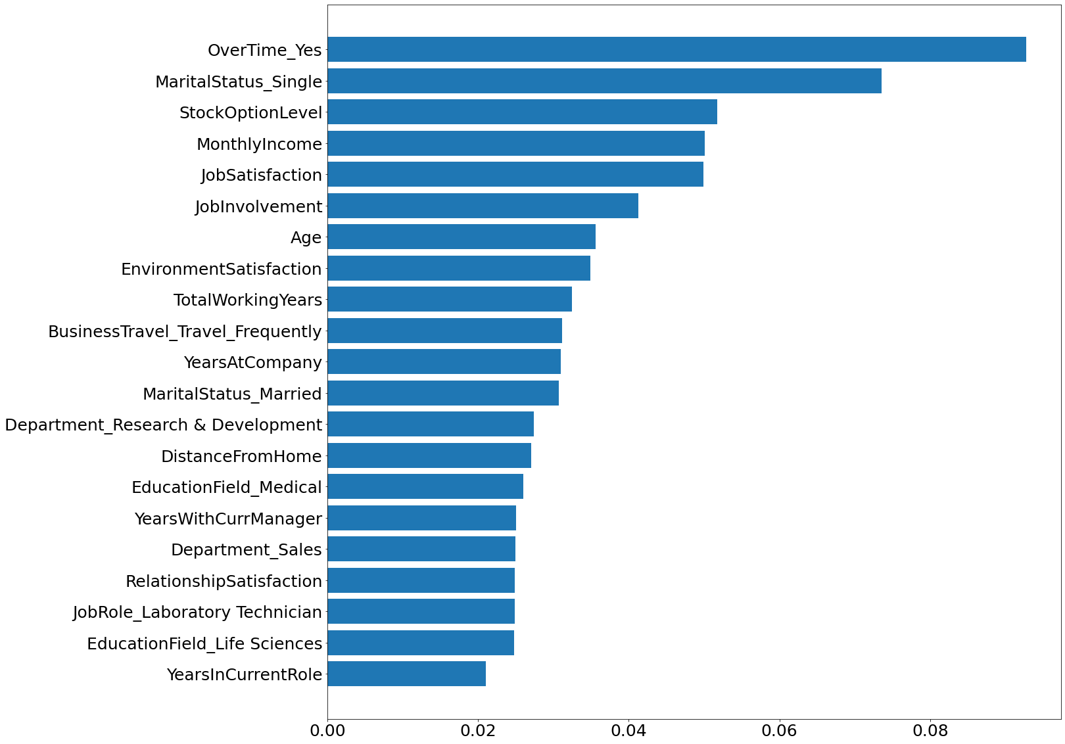
Features Importance and Significant Test
Top 5 Features by Feature Importance
Feature | Inference
Overtime_Yes | Employees working overtime have a higher chance of leaving than others
MaritalStatus_Single | Single employees are having higher attrition rates as compared to married ones
StockOptionLevel | Employees owning IBM Stocks are having lower attrition and less likely to leave as compared to others
MonthlyIncome | Lower incomes can be a significant cause for an employee to leave
JobSatisfaction | Lower job satisfaction can be a potential cause of employees leaving
Feature importance in classifying attrition

Slide 18
How to craft our retention strategy?
Naïve Solution: Retain all the leaving employees.
Can we do better?
Can we link EEV to Employee Retention?
Can we calculate potential loss in terms of cost to IBM if a specific employee leaves?
Business objective: Minimize potential loss to company due to attrition and retain high value employees.

Slide 19
Calculating the EEV
Overall Metric:
Employee Estimated Value (EEV) = Experience + Performance + Environment
Based on the formula of Individual EEV :
EEV = w1 x Performance + w2 x Experience + w3 x Environment
Weights: [w1 = 0.5 , w2 = 0.3, w3 = 0.2 ]
Working through the variables, the following 6 variables are the most representative due to their correlation
Respective weights for calculating the cost of attrition:
 | Variables (Weight) | Variables (Weight)
Performance [0.5] | PercentSalaryHike(0.25) | PerformanceRating(0.25)
Experience [0.3]: | YearsAtCompany(0.15) | TotalWorkingYears(0.15)
Environment [0.2] | JobLevel(0.1) | JobSatisfaction(0.1)

Slide 20
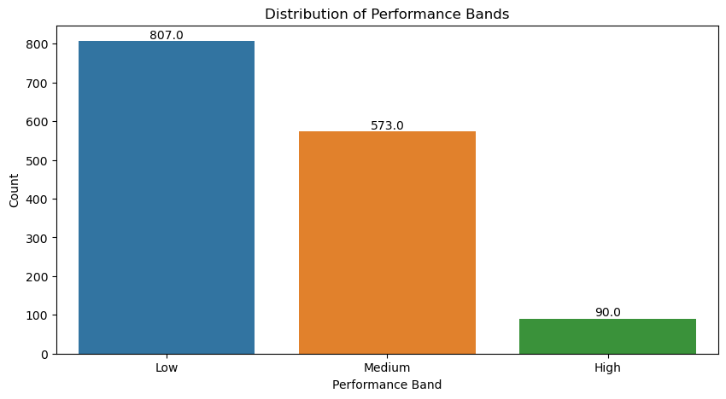
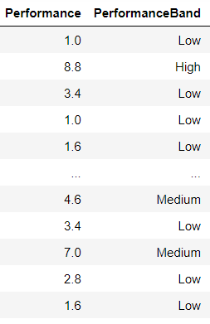
Calculating the EEV (Deriving Bands)
3 distinct bands are derived for classification of employees: High, Medium, Low
Employees classified into a band based on the weighted EEV
EEV range from a [1,10] performance scale
Bins (cut points): [ 0 (Low) 4 - (Medium) 7 - (High) 10. ]
Low performing employees observed to have the highest proportion
Metric:
Cost of Attrition
Sub-objective 2:
Retention strategy for at-risk employees
Calculate cost of attrition of each employee
Management decision for targeted efforts for retention of at-risk employees
Notes:
How we derived the bands - based on the weight EEV - came up with a banding based on scores of 1-10

Slide 21
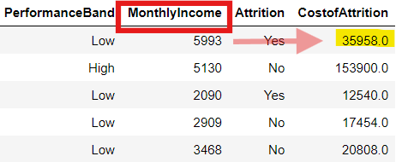
Deriving cost of attrition from EEV
Cost to the company ranging from 50%–250% of an employee's annual salary which attrits
Monthly Income for each employee based on banding is incorporated to calculate the cost of attrition
Metric:
Cost of Attrition
Sub-objective 2:
Retention strategy for at-risk employees
Employee (Performance Band) | % of Cost for Attrition
High | 250%
Medium | 150%
Low | 100%
Calculate cost of attrition of each employee
Management decision for targeted efforts for retention of at-risk employees
Notes:
From the EEV - 50, 150, 250
For each employee lost, the cost to the company could be 50%–250% of his/her annual salary
Training, Hiring, revenue lost.
1 to 1 replacement
Medium and High more intangible items (which may not be resolved from hiring a new employee)

Slide 22
Cost of attrition (Yearly / Employee)
Similarly, low performing group forms the greatest proportion
Total cost wise, the low & medium - performance group contributes to the greatest cost
However, for average cost per employee a high performing employee will be 2.3x more than a medium employee and nearly 5x more than a low performing employee
Metric:
Cost of Attrition
Sub-objective 2:
Retention strategy for at-risk employees
Calculate cost of attrition of each employee
Management decision for targeted efforts for retention of at-risk employees
Employee Band | Count of employee: Attrition (Y) | Total Cost | Average Cost per Employee
High | 7 | 1,722,450 | 246,064
Medium | 70 | 7,425,072 | 106,072
Low | 160 | 7,975,464 | 49,846
Notes:
Pie chart
Comparison of average
Plot simple bar chart of average cost of attrition per year / per employee

Slide 23
Management Decisions
Execution/Strategy | Scenario 1: Retain High Performers | Scenario 2: Retain Low Performers | Scenario 3: Retain a mixed band
Budget | Compensation & Benefits: High Training & Development: Moderate to High Retention Programs: High | Compensation & Benefits: Low Training & Development: High Management & Supervision: Moderate | Compensation & Benefits: Variable (High for high performers, lower for others) Training & Development: High (tailored to each band) Performance Management System: Moderate to High
Programs | Retention programs targeting high performers, such as competitive salary packages, stock options, bonuses, and other financial incentives. | Extensive training programs to uplift the skills of low performers. Skill enhancement workshops, and mentorship programs to help them improve. | Cross-training and mentoring across different performance bands to foster a culture of learning and development.
Performance Management | Clear and fast-tracked career paths for high performers. For them to see a future within the company, which can help in reducing attrition rates | Optimize processes and workflows, implement technology solutions that assist in automating routine tasks and improving efficiency. | Identify high potentials across all performance bands and provide them with growth opportunities
Justifications | High performers likely contribute significantly to the company's productivity and innovation. | A larger workforce can handle more tasks, even if individual productivity is lower. | Leverage the strengths of high performers while maintaining cost efficiency with medium and low performers.
Metric:
Cost of Attrition
Sub-objective 2:
Retention strategy for at-risk employees
Calculate cost of attrition of each employee
Management decision for targeted efforts for retention of at-risk employees
Notes:
The attributed cost per employee -
Management perspective - strategies that can be applied
Cost consideration work within budget
Priority list based on EEV mgmt choose which band to stop on leaving. To keep high / low / medium / mixed to maximise cost
Pass it to mgmt to decide what is the budget and which group they want to target this data given to mgmt they can make this choices
Any possible use case scenario. List three. Assume mgmt wants to focus on high band then this is the scenario

Slide 24

Sub-objective 2: Improve Performance
Identify factors impacting performance
Propose effective recommendations with data science approach
Notes:
To improve performance which is a component in EEV, we first want to identify the key significant factor impacting performance by examining the high performers
This will allow us to then propose effective recommendation targeting the particular significant factor using a data science approach

Slide 25
Sub-objective 2: Improve Performance
Metric:
Performance level
Approach: Segment the employees by features
Better HR policies customized to increase performance based on high performers
High homogeneity within high performers
Using notion of distance
Data Science Tasks:
Classify type of performers by segmentation
Preliminary: K-means Clustering with PCA Analysis method
Using Distance: Identifying Common Features Differentiating High and Low Performers using Gower’s Distance
Recommendation: Based on the most significant feature identified, to provide HR benefit to all employees while maximizing budget
Greedy approach – provide most benefit to highest performer
Maximal approach – provide benefit based on next highest improvement in performance
Sub-objective 2:
Improve Performance
(Performance)
Identify factors impacting performance
Maximizing budget for benefits to improve identified factor for performance
Notes:
Firstly, we will need to segment the employees into high, average and low performers
As we are interested in the high performers, what differentiate them in terms of features – we aim to use notion of distance in order to differentiate the type of performers
Hence, we used k-means as unsupervised method preliminary via PCA analysis – to identify which feature is more significant
Thereafter, using Gower’s distance, we can then differentiate a high performer and average performer for better understanding
Finally, we recommend a HR benefit solution which targets most significant factor identified, while maximising a given budget

Slide 26
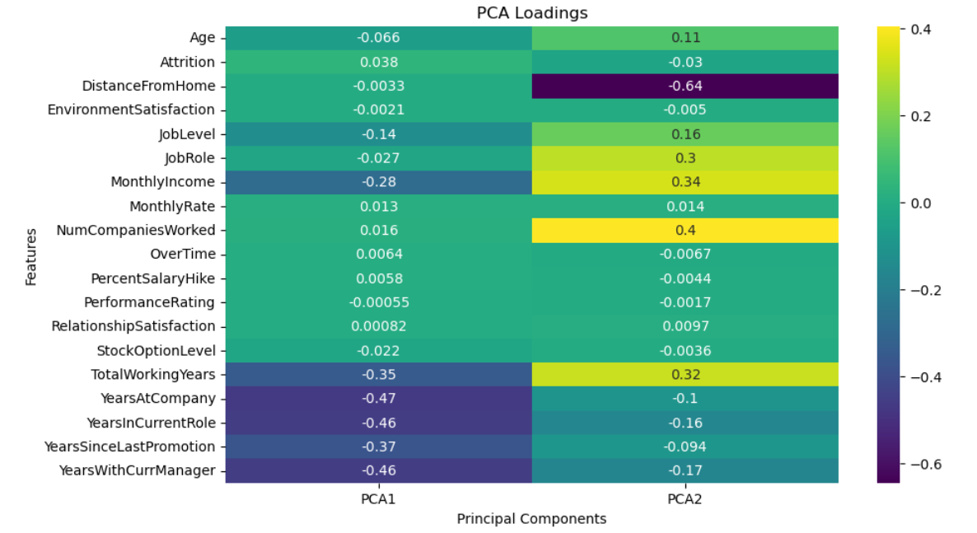
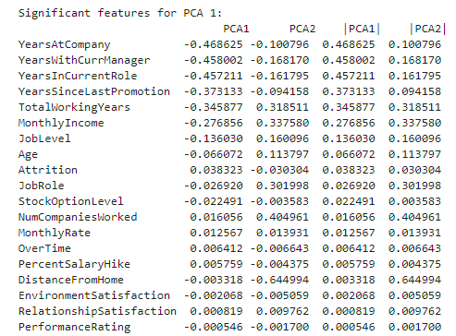
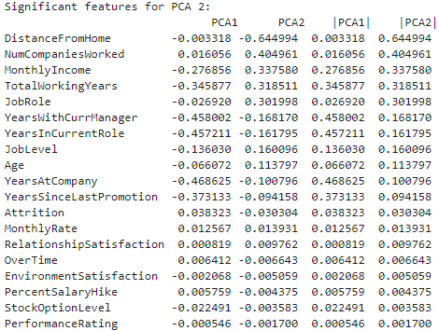
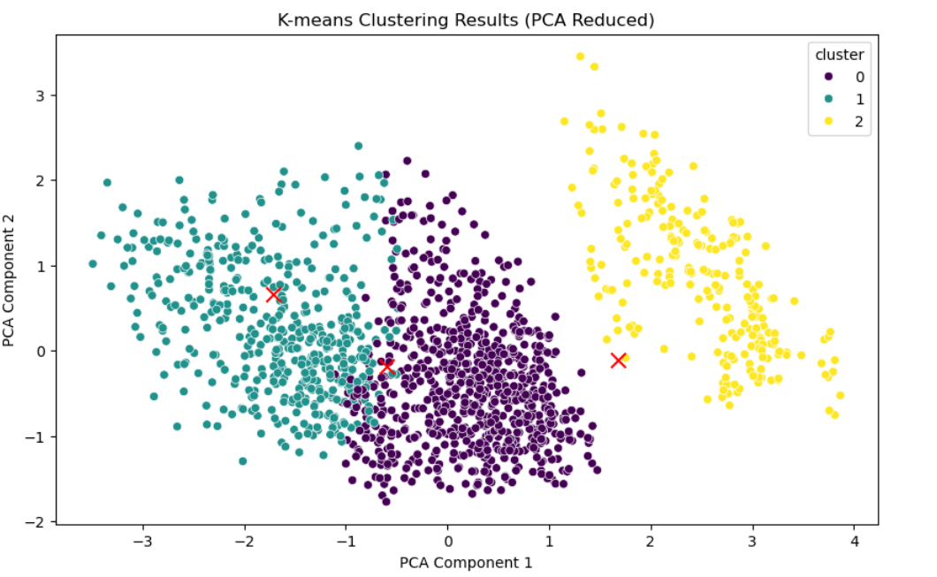
Identify Factors Impacting Performance with K-Means
Preliminary: K-means Clustering with PCA Analysis method
Key finding: Distance from Home is identified as the most significant variable used in PCA
Metric:
Performance level
Top 3 | Variables | Significance [High (>0.5), Moderate (>0.3)]
1 | Distance from Home | High
2 | Years at company | Moderate
3 | Years With Current Manager | Moderate
Sub-objective 2:
Improve Performance
(Performance)
Identify factors impacting performance
Maximizing budget for benefits to improve identified factor for performance
Notes:
Using K-means for segmentation, taking into account elbow method – we derived key feature of distance from home as the most significant variable based on PCA analysis, as it had the highest magnitude of loadings. This meant that distance from home had the strongest the strongest influence – in segmenting the clusters

Slide 27
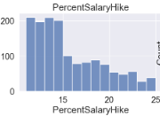
Identifying Common Features Differentiating High and Low Performers using Gower’s Distance
Metric:
Performance level
Comparing Average High Performer vs Average Low Performer
Defining High and Low Performers
Sub-objective 2:
Improve Performance
(Performance)
Assumption: Percent Salary Hike used by IBM to reward employees according to their performance in finer grain
Percent Salary Hike value
90% percentile = High Performer (22-25%for Percent Salary Hike)
10% percentile = Low performer (11% for Percent Salary Hike)
Identify factors impacting performance
Maximizing budget for benefits to improve identified factor for performance
k-Medoids clustering algorithm (symmetric distance matrix)
K-Mediods algorithm, using k = 1
Single cluster to find one representative in each high and low performer category
For distance/similarity measure, Gower’s Distance is used because: Features are mixed-type (e.g. numerical, categorical, etc.)
Notes:
Next, to Discover common features through frequency pattern mining
Since about 85% of the employees falls under the PerformanceRating of 3 and 15% falls under 4, we need a better measure for the performance.
Assumption: PercentSalaryHike is used by IBM to reward employees according to their performance in finer grain within the PerformanceRating banding. (Confirmed through K-means Clustering)
Use PercentSalaryHike to differentiate between IBM top and bottom 10% employees as High and Low performer.
To gain medoids of each cluster (High and Low performer), the k-Medoids clustering algorithm is utilized which partitions instances based on their positions in a latent space (symmetric distance matrix).
K-Mediods algorithm, using k = 1
Single cluster to find one representative in each high and low performer category
For distance/similarity measure, Gower’s Distance is used because:
Features are mixed-type (e.g. numeric, categorical, etc.)

Slide 28
Identify Important Factors Impacting Performance
Identifying Common Features Differentiating High and Low Performers using Gower’s Distance
Metric:
Performance level
Comparing Average High Performer vs Average Low Performer
Types | Variable
Experience | Years at Company
 | Years in Current Role
 | Years Since Last Promotion
 | Years with Current Manager
 | Number of companies worked
 | Total Working Years
Compensation | Monthly income
Profile | Age
Other Factors | Distance from Home
Sale Dept
High Perf | Low Perf
6 | 9
5 | 8
1 | 7
4 | 7
1 | 0
6 | 10
6,274 | 9,924
34 | 38
2 | 14
R&D Dept
High Perf | Low Perf
5 | 4
4 | 3
0 | 1
4 | 3
0 | 2
6 | 15
2,703 | 2,013
29 | 36
2 | 7
Sub-objective 2:
Improve Performance
(Performance)
Identify factors impacting performance
Maximizing budget for benefits to improve identified factor for performance
Observations |  | HR Strategy
Experience | Generally, low performing employees are at 10 to 15 years of total working years. Sale Dept low performer over-due promotion. | Engagement of employees who are in the workforce for 10-15 years. Possible sabbatical leaves. Review promotion. Internal mobility – lateral career move.
Compensation | Higher monthly income does not translate directly to higher performance. | Review income and performance interaction.
Profile | Low performers are generally older than high performers in the same department. Low performers generally in their mid-30s. | Differentiate between employees who might have higher family burden vs employees with training needs.
Other Factors | Generally, high performers lives closer to office compared to low performers across all departments. | One-Time house moving grant. Flexible Work Arrangements.
[Appendix]
Notes:
We then compared a high performer and low performer based on departments – we realized that the key feature of distance from home is more significant feature in R&D department than Sale department
We also conducted further comparison by department, job role and gender – listed in appendix slides for fine grain analysis

Slide 29
HR Recommendation: Transportation Benefit based on performance for R&D Employees
Metric:
Performance level
Overall Metric: Employee Estimated Value (EEV) =
Experience + Performance + Environment
Performance Components | Weight
Percentage Salary Hike | 0.5
Performance Rating | 0.5
Sub-objective 2:
Improve Performance
(Performance)
Most Significant Factor = Distance from Home
Distance from Home ranges from 0 to 25Km
Identify factors impacting performance
Constraints and Assumptions
Budget can be set at $X
Maximum amount of performance improvement for employee
Greedy approach – provide most benefit to highest performer
Maximal approach – provide benefit based on next highest improvement in performance
Maximizing budget for benefits to improve identified factor for performance
Notes:
To measure performance – we used two key variables in our dataset which are percentage salary hike and performance rating
Taking an equal 0.5 weightage for each component, we are able to compute the performance for each employee and rank them from high to low
From our earlier finding, most significant factor is distance from home, with range of 0 to 25km based on our dataset
Taking constraint and assumption
We are able to set the budget to any arbitrary number $X
We also assume that there is maximum amount of performance improvement for employee – meaning to say that each employee can improve up to a certain performance level – given that it is difficult to improve performance beyond a certain threshold.
With that, we will first explain the greedy approach – which aims to provide most benefit to a person before moving on to the next person in line.

Slide 30
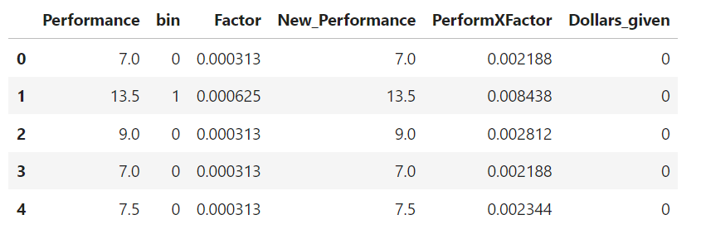

HR Recommendation: Transportation Benefit based on performance for R&D Employees
Metric:
Performance level
Constraints and Assumptions
Budget can be set at $X
Maximum amount of performance improvement for employee
Greedy approach – provide most benefit to highest performer
All R&D employees were binned from 0 to 5 by distance from home for every 5km
Further away the employee is (i.e. Bin 5), every $1 of transport benefit is worth more to the employee
Derive “Factor” - potential amount of improvement in performance based on bins
Based on employee overall performance score, higher performers were prioritized
Sub-objective 2:
Improve Performance
(Performance)
Identify factors impacting performance
Maximizing budget for benefits to improve identified factor for performance
Set New_Performance = Performance before running algorithm
PerformXFactor = every $1 improvement in performance
Dollars_given = round of $1 distributed to the employee
Notes:
We recommend to provide transportation benefit to R&D employees, given that this was an important feature identified from our earlier analysis
As a start, we binned the R&D employees from 0 to 5 based on their distance from home for every 5km
We assume that every $1 is valued more for those employee who stay further away (in bin 5), as compared to those who stay close to the company in bin 0
With that assumption, we allocated a factor – which is the amount of improvement in performance based on distance
Then, we proceed to sort the employees, with higher performer prioritized

Slide 31
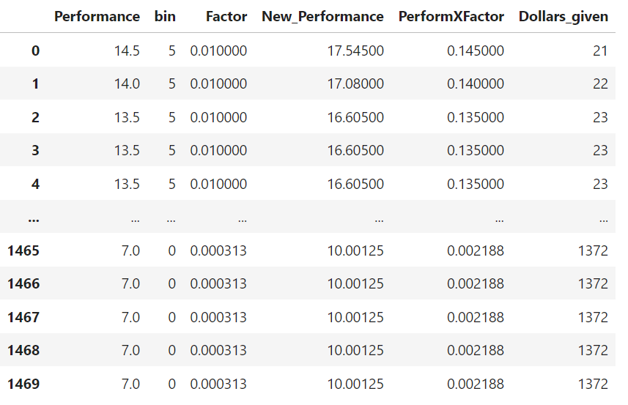
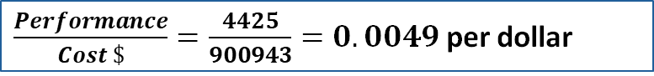
HR Recommendation: Transportation Benefit based on performance for R&D Employees
Metric:
Performance level
$\frac{Performance}{Cost \$}=\frac{4425}{900943}=0.0049$ per dollar
Scenario 1: No Budget Constraints
Constraints and Assumptions
Budget can be set at $X → Infinity
Maximum amount of performance improvement for employee → 3
Sub-objective 2:
Improve Performance
(Performance)
Greedy approach – provide most benefit to highest performer
Pseudo Code:
While employee new performance – old performance is lesser than the cap of 3 and budget is > 0, give a dollar to the employee
Move to next employee in line once abovementioned conditions does not hold
Total budget distributed: $900943
Total improvement in performance: 4425
Low performers have most room to grow, hence most amount allocated
Unrealistic for $90K to be allocated to transportation benefit
Identify factors impacting performance
Maximizing budget for benefits to improve identified factor for performance
Notes:
In first scenario, for simplicity we take the case of no budget contain, meaning to say the $X is now infinity
Maximum amount of performance improvement to be cap at 3
Taking the highest performer, we first analyze, if the employee new performance is less than the cap of 3 and that budget is >0, we are able to give $1 to the employee
This process continues until the cap of 3 is reached for this high performer, before moving to the next second highest perfomer ranked
With that, we realized the budget distributed is 900K which is unrealistic in the real world, yet the total improvement in performance is only 4425. Taking measure of performance improvement per dollar, we derived 0.0049 per dollar which is low
Moreover, we realized we unexpectedly pirorized the low performer instead, given that they have highest room for improvement, they are likely to gain more benefit dollars as compared to a performer who is already high performing and near his or her maximum amount of performance improvement to begin with.
Therefore, we move on to explore if we set a budget constraint

Slide 32
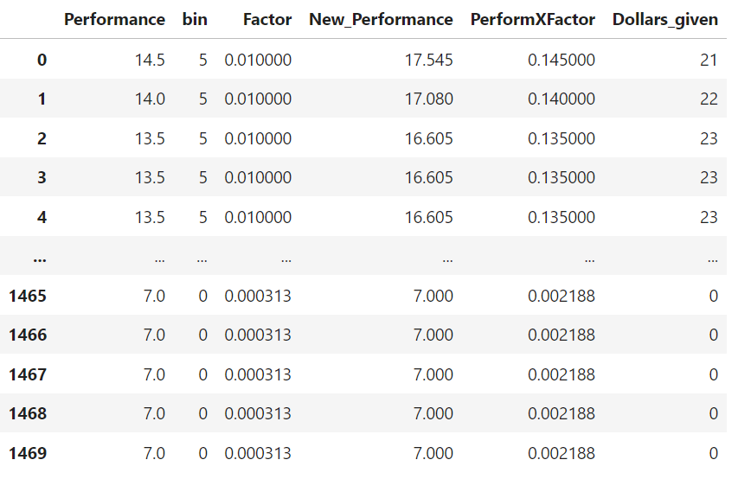
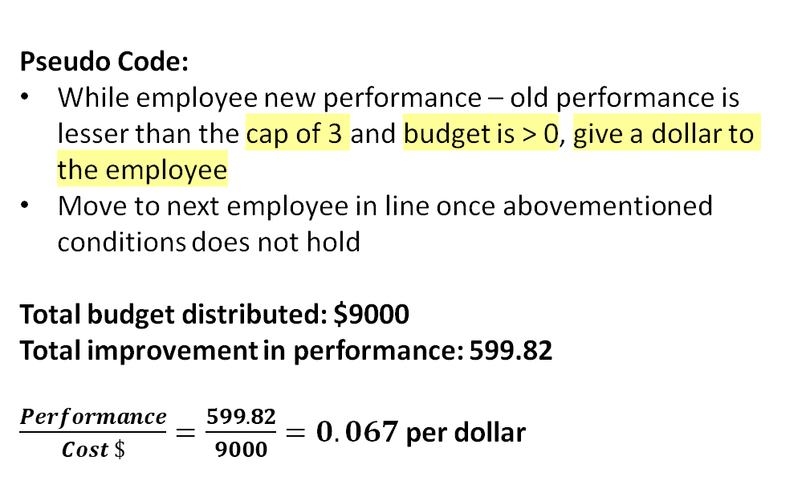
HR Recommendation: Transportation Benefit based on performance for R&D Employees
Metric:
Performance level
Scenario 2: Budget Constraint
Constraints and Assumptions
Budget can be set at $X → $9000
Maximum amount of performance improvement for employee → 3
Sub-objective 2:
Improve Performance
(Performance)
Greedy approach – provide most benefit to highest performer
Pseudo Code:
While employee new performance – old performance is lesser than the cap of 3 and budget is > 0, give a dollar to the employee
Move to next employee in line once abovementioned conditions does not hold
Total budget distributed: $9000
Total improvement in performance: 599.82
$\frac{Performance}{Cost \$}=\frac{599.82}{9000}=0.067$ per dollar
Identify factors impacting performance
Maximizing budget for benefits to improve identified factor for performance
Notes:
In scenario 2, we set a budget limit of $9K which is a more realistic assumption
Keeping the cap as 3 same as in previous scenario, we allocate every dollar again. This time, we have maximise the $9K allocated to all employees, and total improvement is 599.82.
We derive a 0.067 per dollar improvement which is much higher than the previous 0.0049 per dollar
Using this model with Complexity: O($N^{2})$ however, due to limitation, we are allocating $1 to the to high performers first, instead of basing on the highest improvement possible performer – who may not necessarily be a high performer to begin with

Slide 33
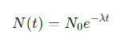
HR Recommendation: Transportation Benefit based on performance for R&D Employees
Metric:
Performance level
Limitations of Greedy approach:
Low performers have most room to grow, hence most amount allocated
Does not account for law of diminishing marginal returns – every $1 given to same employee will achieve lesser improvement of performance than previous $1
Brute force approach
Sub-objective 2:
Improve Performance
(Performance)
Maximal approach – provide benefit based on next highest improvement in performance
Constraints and Assumptions
Budget can be set at $X
Maximum amount of performance improvement for employee → 3
Identify factors impacting performance
Introduce exponential decay: Degradation factor
Pseudo Code:
While employee new performance – old performance is lesser than the cap of 3 and budget is > 0, give a dollar to the employee
Identify the next best employee with highest potential improvement in performance based on degradation factor
After every dollar allocated to employee, factor improvement will reduce by degradation factor
Iterate until budget $X is allocated
Maximizing budget for benefits to improve identified factor for performance
Is the factor for performance improvement at time t
Is the initial factor improvement for performance
Lambda is the decay constant
Notes:
Due to limitation of our greedy approach – it does not account for the law of diminishing marginal returns.
Every $1 given to same employee will achieve a lesser improvement in performance than prior $1
In order to take this concept into account, we will need a better approach using a maximal approach – by allocating every dollar based on highest improvement in performance
Same constraints can be set for budget and cap in performance, however the difference here is the introduction of a degradation factor
This degradation factor derived from the equation here N(t) = N0e^lambda * time – this would degrade the improvement in performance with exponential rate after every dollar is given to a perfomer.
Now, instead of having the same factor improvement unlike our greedy approach, dollar is allocated to next best highest potential improvement of a performer to best allocate the dollar in hand after taking into account degradation. This iteration continues until all budget is allocated.
Hence, this data science thinking approach can be performed with any arbitrary budget and cap in performance based on the company HR strategy, achieving our subobjective of increasing performance through HR strategy of transportation benefit while ensuring every $1 given through this program will truly help improve overall performance, thereby improving overall EVV of the company.

Slide 34

Sub-objective 3: Improve Satisfaction Scores
Identify factors impacting promotion and timeline
Recommend suitable promotion timepoint
Notes:
In this part, we will discuss the Satisfaction factors that affect employee promotion, point out the appropriate promotion time and how to improve employee Satisfaction.
I will talk about our approach to modeling employee promotions by using key features associated with employee satisfaction.

Slide 35
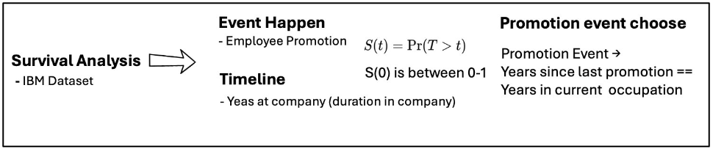
Sub-objective 3: Improve Satisfaction Score
Metric:
Satisfaction level
Approach: To model Promotion as an event, with important features used in Satisfaction
Find and weighted features.
Assoicate satisfaction score with promotion
Compare different employee group
Data Science Tasks:
Consider Survival Analysis
All the promotion event happen
during IBM employment time without
consideing their lifetime
Consider Cox PH Model
Compare with Weibull AFT
Compare with Random Survival
Decision Tree to identify important features for promotion
Recommendation: Based on the most significant feature identified for Job Satisfaction level, and provide suitable promotion timeline
Features in Job Satisfaction scores.
Promotion Timeline.
Sub-objective 3:
Improve Satisfaction
(Environment)
Identify factors impacting Promotion
Associate satisfaction with promotion
Recommend
Promotion Timeline
Notes:
Our overall goal is to identify the significant features that influence promotions and use this information to provide actionable recommendations.
We began by identifying important features related to employee satisfaction, such as Job Satisfaction, Job Level, Job Involvement, and Environment Satisfaction.
These features were weighted based on their importance in predicting promotions.
We then associated the overall satisfaction score with promotion events to compare different groups of employees.
In Data Science Tasks:
We focused on the duration of employees' tenure at IBM, considering promotion events occurring during their employment period
We used Cox Proportional Hazards Model to evaluate the relationship between the time to promotion and the selected features.
A decision tree was utilized to identify and visualize the most significant features for predicting promotions.
Based on our analysis, we identified the most influential features contributing to job satisfaction and their corresponding weights.
By understanding the significant features, we can provide a suitable timeline for promotions, ensuring that employees' job satisfaction is taken into account.

Slide 36
Method Select
Metric:
Satisfaction level
Requirement
All the promotion event happen during IBM employment time
Sub-objective 3:
Improve Satisfaction
(Environment)
Promotion
Employment Time
Censorship for the employee without promotion during certain employment time
Identify factors impacting Promotion
Performance
Build metric that can represent the performance
Associate satisfaction with promotion
Method
Recommend
Promotion Timeline
Notes:
The reason why we choose survival analysis is because We need to look at the length of an employee's tenure at IBM, taking into account promotions that occurred during their employment

Slide 37
Models to Determine Promotion Factors
Metric:
Satisfaction level
Model Test
Cox PH Model
Semi-parametric
Cox-Snell Residuals, AIC, BIC, Concordance Index (C-index)
Sub-objective 3:
Improve Satisfaction
(Environment)
Weibull AFT Model
Parametric
C-index, AIC, BIC
Choose C-index to evaluate model:
The Cox PH Model has the highest index 0.915
Non-parametric
C-index, AIC, BIC
Identify factors impacting Promotion
Random Survival Model
Data Prepare
Associate satisfaction with promotion
Clean & bin
Define using gower distance
Features | Utilization
NumCompaniesWorked | Bin 0-3
TotalWorkingYears | Bin 0-20
YearsInCurrentRole | Bin 0-10
YearsInCurrentRole | Bin 0-10
Features | Utilization
High_perf | 4
Good_perf | 3
Average_pef | 2
Low_pef | 1
Recommend
Promotion Timeline
Notes:
And why we choose Cox Proportional Hazards Model is because it has the highest C-index 0.9, which most cater to our analysis, below are some bins we solve the dataset

Slide 38
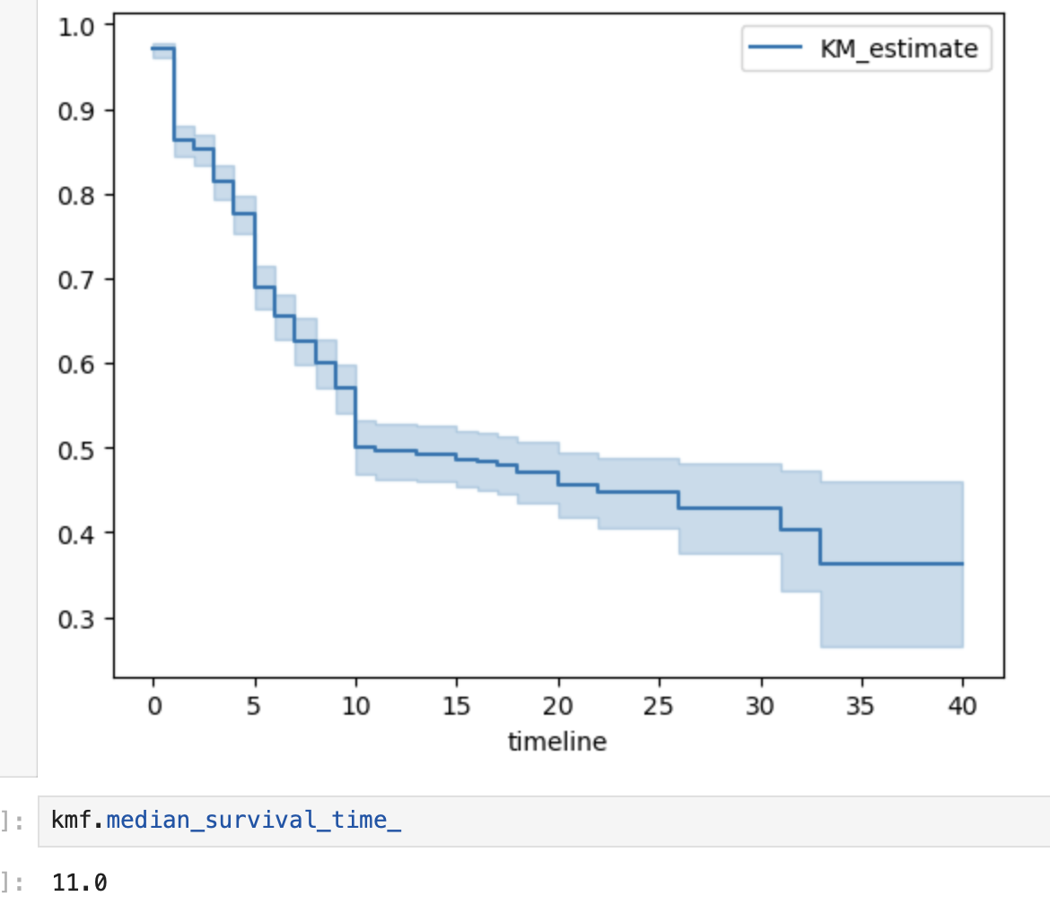

Promotion using Survival Regression – with Factors (Cox model)
Factors that are important for promotion
Metric:
Satisfaction level
All the four variables below have strong association with promotion (p-value < 0.05)
Sub-objective 3:
Improve Satisfaction
(Environment)
Factors | Hazard Ratio | Interpretation
JobSatisfaction | 0.88 < 1 | Employees with one level higher job satisfaction have a 12% lower likelihood of being promoted
MonthlyIncome （k） | 1.02 > 1 | Employees with higher monthly incomes are slightly more likely to be promoted
NumCompanyWork | 0.04 < 1 | Employees who have worked for many different companies are much less likely to be promoted
PercentSalaryHike | 0.02 < 1 | Employees who receive larger percentage salary hikes are much less likely to be promoted
Identify factors impacting Promotion
Associate satisfaction with promotion
Recommend
Promotion Timeline
Notes:
We first use survival function to see how the probability is changed with time growing, the blue line represents the promotion event happen through the timeline. Here is a significant decline in the initial 10 years, and then after 10 years the opportunity for an employee to promote is approaching 30% gradually, meanwhile, the median of the plot is 11 years which shows a 50% distribute in certain time plot.
to find the factors which have a strong association with promotion based on p-value. The four factors are JobSatisfaction, MonthlyIncome, NumCompanyWork, PercentSalaryHike, with different hazard ratio. Using the job satisfaction as an example, the hazard ration is 0.88, which means one level higher job satisfaction have a 12% lower likelihood of being promoted

Slide 39
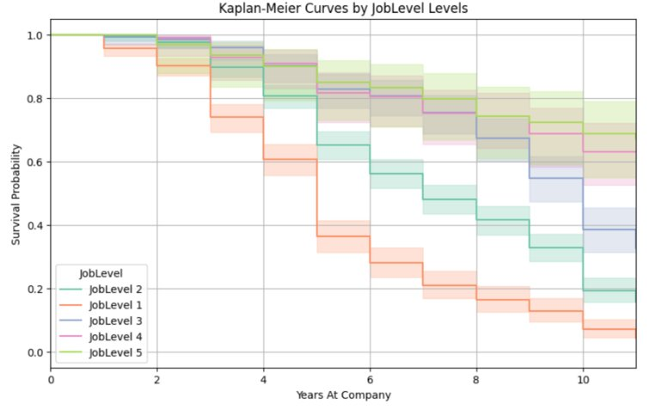
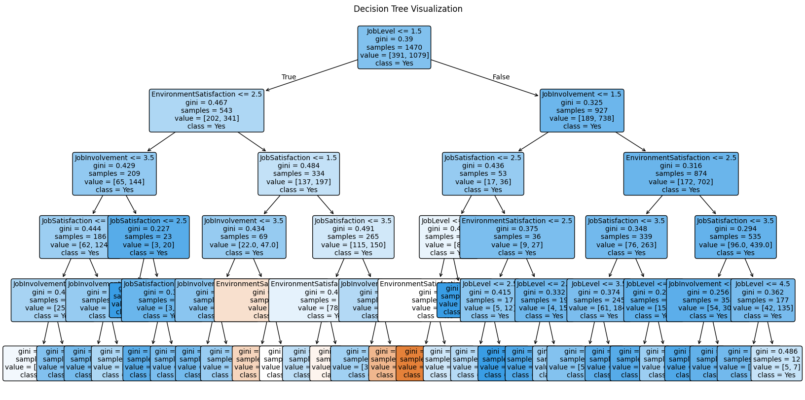
Satisfaction Level
Decision tree and feature importance
Metric:
Satisfaction level
Sub-objective 3:
Improve Satisfaction
(Environment)
Identify factors impacting Promotion
Associate satisfaction with promotion
Feature | Weight
Job Level | 0.68
Job Satisfaction | 0.10
Job Involvement | 0.11
Environment Satisfaction | 0.11
Satisfaction Scores = 0.68 * Job Level + 0.11 * Job Involvement + 0.11 * Environment Satisfaction + 0.1 * Job Satisfaction
Observation:
Employees with delays in promotion may face lower satisfaction scores due to reduced motivation and engagement.
Lower-level employees encounter more frequent promotion opportunities, reflecting organizational structures or career paths
Accumulated experience enhance promotion, highlighting the role of tenure and professional development in career advancement.
Recommend
Promotion Timeline
Since the bin is same, no need for normalize
Notes:
Here are some insights underscore the relationship between employee satisfaction, with promotion policies.
decision tree we build fit a feature importance contain job level, job satisfaction, job Involvement and environment Satifaction, we can know that delays in promotion may face lower satisfaction scores due to reduced motivation and engagement.​. This could stem from reduced motivation and engagement impacting their career advancement.
Otherwise, Employees at lower job levels often encounter more frequent opportunities for advancement, reflecting organizational structures or available career paths.
What’s more, The accumulation of experience and accomplishments over time tends to enhance an employee's eligibility for promotion. This underscores the role of tenure and ongoing professional development in shaping promotion prospects within the organization.

Slide 40
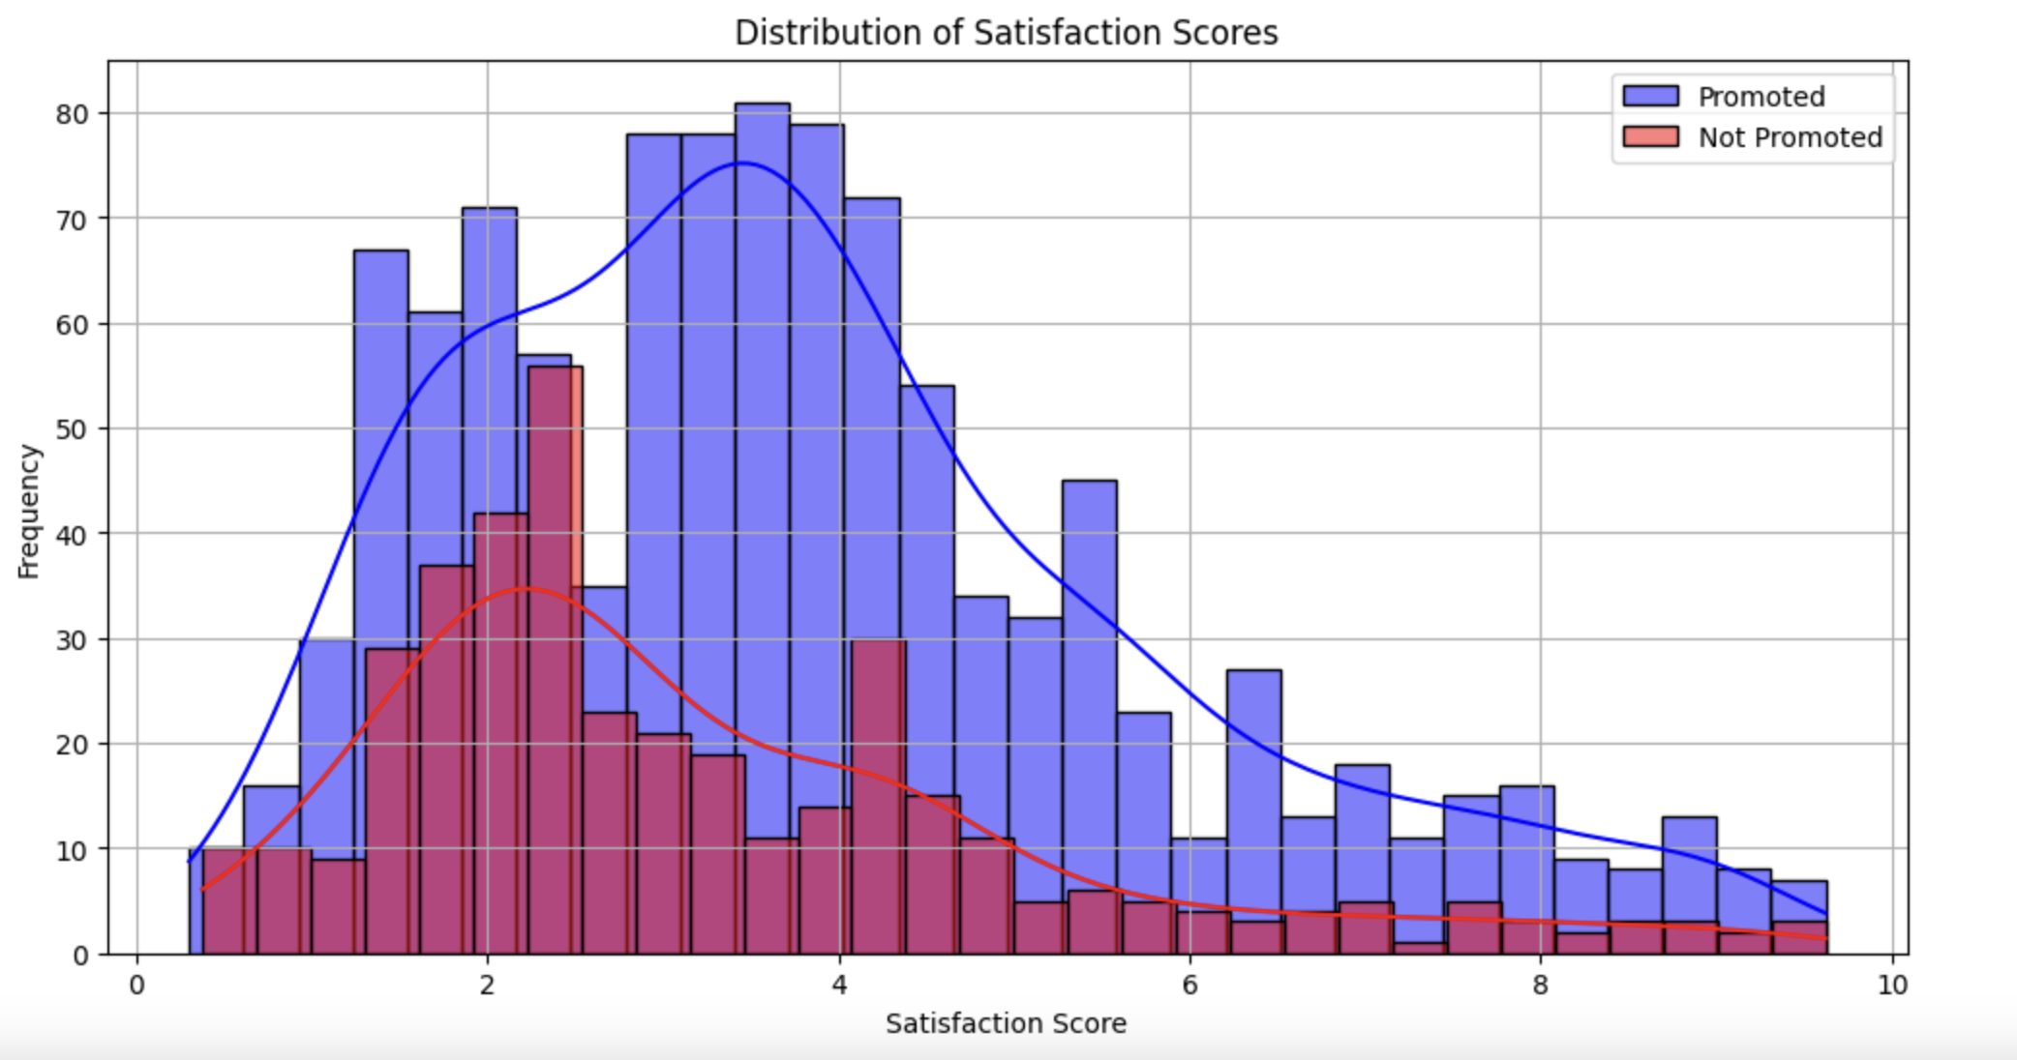
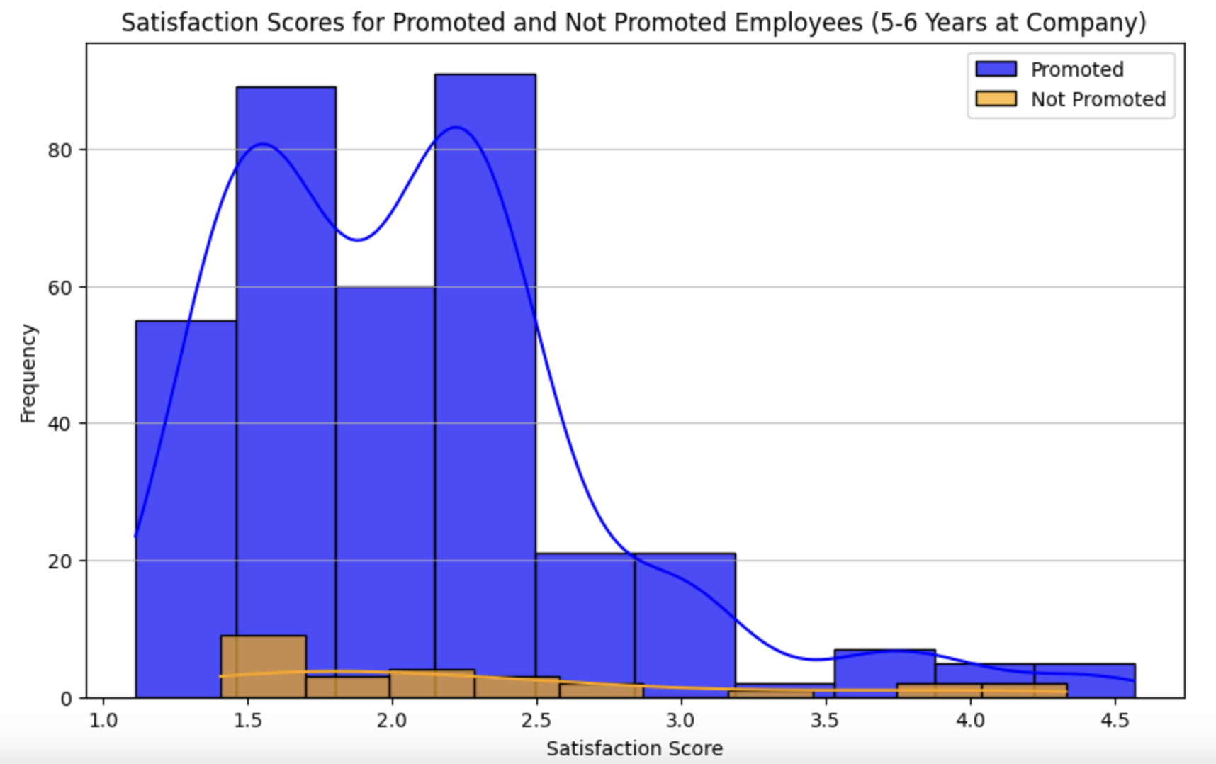
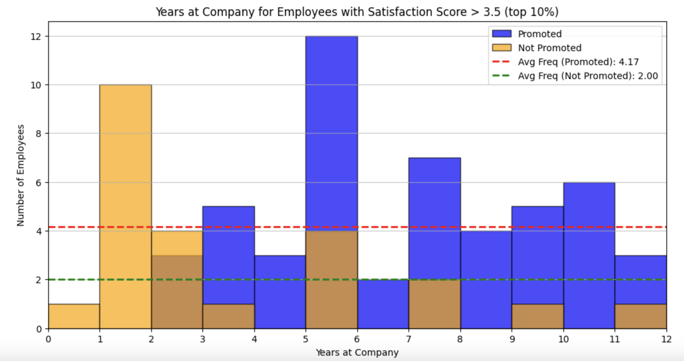
Promotion & Improve Job Satisfaction
Metric:
Satisfaction level
Sub-objective 3:
Improve Satisfaction
(Environment)
Identify factors impacting Promotion
Associate satisfaction with promotion
HR Strategy in Employee Satisfaction:
The employee satisfaction will finally decrease to 0 without promotion with at company years increase
5-6 years will be a good timepoint to make a promotion for employee, since employee who get promotion at this timepoint will gain highest satisfaction
Recommend
Promotion Timeline
Notes:
At last, we will make a promotion timing and ongoing efforts to sustain employee satisfaction.
Form the distribution of satisfaction scores, We find that there appears to be a trend where employee satisfaction decreases as tenure at the company increases, whicheventually reaches lower levels or even zero. This underscores the importance of proactive HR strategies to maintain and boost satisfaction levels over time.
Moreover, employees who are promoted around the 5-6 year mark tend to experience higher satisfaction levels. This suggests that strategically timing promotions can significantly impact employee satisfaction and potentially retention.

Slide 41
Sub-objective 3: Improve Satisfaction Scores
Causal relationship between benefit and satisfaction level

Slide 42

Causal Modelling
Metric:
Worklife balance score/
Satisfaction score
A/B Test
Benefits and perks
Data
Benefits and perks
Use A/B test to find causal relationship between benefits and satisfaction level
Control Group
Treatment Group
Recommending the best benefit to be implemented
work life balance score
environmental satisfaction score
(fixed office hours and locations)​
t-test​
Score comparing​
Notes:
How does this satisfaction score link back to EEV?

Slide 43
Example
Benefit: Flexible Work Arrangements
Control group | Fix 8h hours one day | company office working
Treatment group | Flexible working hours / day 40h / week | 2 days at home 3 days at company
 | WLB Score | environmental satisfaction score | P-value
Control group | 2.3 | 2.7 | <0.05
Treatment group | 3.8 | 3.5 | <0.05

Slide 44
Analytical Framework​
Overall Metric:
Employee Estimated Value (EEV) = Experience + Performance + Environment
Business Problem | Sub-Objectives | Data Science Solution | Implementation | Sub-Metric
Priority list for employees to retain based on cost constraint
Random Forest
Lengthen Tenure
(Experience)
Cost of Attrition
How can we optimize cost when improving individual Employee Estimated Value (EEV)?
Maximizing transport benefit budget based on distance from home
K-means & Gower Distance
Performance level
Improve Performance
(Performance)
Survival Model
4-6 years for employee to get promotion
Satisfaction level
Improve Satisfaction Scores
(Environment)
A/B Test
Flexible Work Arrangement
WLB score
Environmental satisfaction score

Slide 45
IBM HR: Closed-Loop Data Eco-System
Automatically flag significant changes in employee value, prompting interventions when necessary​
Recommendation for at risk employees​
Monitors changes in individual EEV over time
Align weightage with company philosophy
Data Analysis and Modelling​
Include more relevant variables for modeling
Re-training of models
Re-evaluate suitability of evaluation metric like the ECR
Data Sources​
Actionable Insights and Intervention​
Enhance data collection.
Fine grain details such as training type, training hours, employee evaluation of training provided​
Reconsider new features / factors for actionable
Collection of new data points from other reports / channels when there is new business objectives​
Evaluation of actionable insights through monitoring alignment to business objective of optimizing cost while improving EEV
Evaluation of Business Objectives​

Slide 46
The End

Slide 47
By Departments - Key Findings
Types | Variable
Experience | Years at Company
 | Years in Current Role
 | Years Since Last Promotion
 | Years with Current Manager
 | Number of companies worked
 | Total Working Years
Compensation | Monthly income
Profile | Age
Other Factors | Distance from Home
Sale Dept
High Perf | Low Perf
6 | 9
5 | 8
1 | 7
4 | 7
1 | 0
6 | 10
6,274 | 9,924
34 | 38
2 | 14
R&D Dept
High Perf | Low Perf
5 | 4
4 | 3
0 | 1
4 | 3
0 | 2
6 | 15
2,703 | 2,013
29 | 36
2 | 7
Metric:
Performance level
Sub-objective 2:
Improve Performance
(Performance)
Identify factors impacting performance
Observations |  | HR Strategy
Experience | Generally, low performing employees are at 10 to 15 years of total working years. Sale Dept low performer over-due promotion. | Engagement of employees who are in the workforce for 10-15 years. Possible sabbatical leaves. Review promotion. Internal mobility – lateral career move.
Compensation | Higher monthly income does not translate directly to higher performance. | Review income and performance interaction.
Profile | Low performers are generally older than high performers in the same department. Low performers generally in their mid-30s. | Differentiate between employees who might have higher family burden vs employees with training needs.
Other Factors | Generally, high performers lives closer to office compared to low performers across all departments. | One-Time house moving grant. Flexible Work Arrangements.
Maximizing budget for benefits to improve identified factor for performance

Slide 48
By Job Roles - Key Findings
Types | Variable
Experience | Years at Company
 | Years in Current Role
 | Years Since Last Promotion
 | Years with Current Manager
 | Number of companies worked
 | Total Working Years
Compensation | Monthly income
Profile | Age
Other Factors | Distance from Home
Sale Representative
High Perf | Low Perf
4 | 2
3 | 2
0 | 0
4 | 1
1 | 1
4 | 2
3,140 | 2,728
41 | 20
20 | 9
Healthcare Representative
High Perf | Low Perf
8 | 10
7 | 7
3 | 0
7 | 5
1 | 1
8 | 10
4,244 | 7,978
40 | 44
2 | 15
Metric:
Performance level
Sub-objective 2:
Improve Performance
(Performance)
Identify factors impacting performance
Observations |  | HR Strategy
Experience | As opposed to department level trend, sale representative with lower experience are lower performer. | Possible more training and development targeted at junior sales representative.
Compensation | Higher monthly income does not translate directly to higher performance. | Review income and performance interaction.
Profile | As opposed to department level trend, younger sale representative are lower performer. | Possible more training and development targeted at junior sales representative.
Other Factors | Sales representative performance are not affected by living far from office | Maintain flexible work arrangement for sales representatives.
Maximizing budget for benefits to improve identified factor for performance

Slide 49
By Gender - Key Findings – R&D Research Scientist
Types | Variable
Experience | Years at Company
 | Years in Current Role
 | Years Since Last Promotion
 | Years with Current Manager
 | Number of companies worked
 | Total Working Years
Compensation | Monthly income
Profile | Age
Other Factors | Distance from Home
Female
High Perf | Low Perf
3 | 6
2 | 2
1 | 1
2 | 4
1 | 1
3 | 6
3,591 | 3,445
28 | 27
1 | 8
Male
High Perf | Low Perf
5 | 6
4 | 4
0 | 0
4 | 2
0 | 1
6 | 6
2,703 | 2,936
29 | 44
2 | 10
Metric:
Performance level
Sub-objective 2:
Improve Performance
(Performance)
Identify factors impacting performance
Observations |  | HR Strategy
Experience | Female may perform worst when under same manager for more years. Male may perform better with more years under the same manager | Possibly more section rotation for Female research scientist.
Compensation | Higher pay for same job role for Female research scientist with similar experience level | Review gender pay gap.
Profile | Observation on higher age for low performing male research scientist may not be valid as the total work years for this representative is just 6 years, which is like the younger research scientists. | Differentiating odd case of low performer in various age group.
Other Factors | Similar observation from department and job role segmentation | No differentiation in HR strategies for either gender
Maximizing budget for benefits to improve identified factor for performance

